Slide 1
the python language, part 1
Python is an interpreted language that has been around since 1990. The current release is version 3.
versus a compiled language, where code is first compiled into machine code, then executed: A two step process
Interpreted languages are more flexible, but less efficient.
Compiled languages are less flexible (must recompile after every change to code) but are very efficient.

Slide 2
the python language, part 2
Python is an interpreted language
Examples of other interpreted languages:
javascript
MATLAB™
Examples of other compiled languages:
c, c++
FORTRAN
java

Slide 3
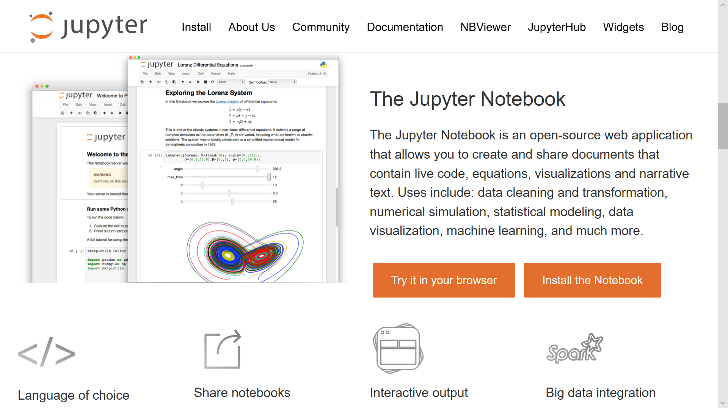
In this class, we will use……….

Slide 4
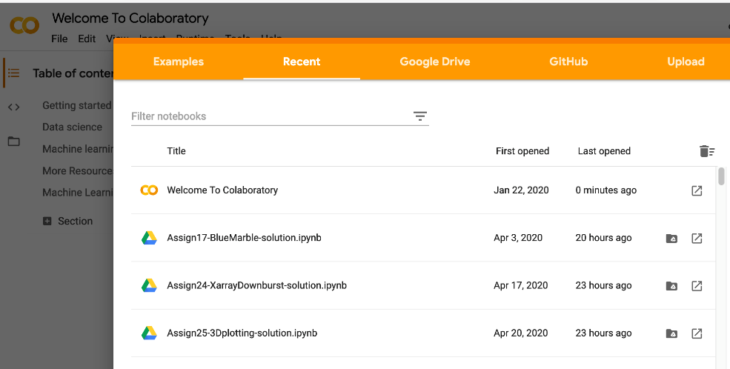
where we code, part 1
1. Google Colaboratory
https://colab.research.google.com
A free resource for writing and running Python
There are alternatives if you cannot use Google resources!
Codes are edited and executed via a web browser
no app need be installed.
Codes run on Google’s cloud servers
Data files can be stored in a Google Drive, or retrieved over the internet for use by your Python programs.
Notes:
Image from Google Colab session.

Slide 5
where we code, part 3
2. Your laptop/PC
Download free Anaconda, including Python, from: https://www.anaconda.com/products/individual
You can run your code on your own machine, using software from Anaconda and other free packages discussed in class
All of the software we will use is free!
3. Other Colab alternatives:
https://www.dataschool.io/cloud-services-for-jupyter-notebook

